Slide 1

Finding Bugs using Path-Sensitive Static Analysis
Gábor Horváth Gabor.Horvath@microsoft.com @XazaxHun
Notes:
Short introduction about static analysis * Introduce the concept of path-sensitivity through examples from MSVC, some small demos * Discuss how path sensitive analysis is implemented - Modeling memory, bindings - The use of solvers, a simple decision procedure - How analysis state is tracked - Other modeling considerations (preconditions, postconditions, how could contracts help) * The tradeoffs of path-sensitive analysis * How to use the path sensitive checks in MSVC - Enabling them, interpreting error messages, dealing with false positives * Upcoming checks and features in MSVC * Conclusion
Path-sensitive static analysis simulates the runtime behavior of the program code and uses the analysis state to evaluate which branches can be taken. It is an effective tool to find non-trivial bugs in code at compile time. While checks based on such analysis can take longer time to run, they have a sophisticated understanding of the code that helps them uncover semantic issues. First, I will discuss how can you turn these checks on and how to make sense of the warning messages they produce. Furthermore, I will do a deep dive on what makes path-sensitive analysis an effective tool to reason about code and how MSVC is leveraging this power to find bugs. In particular, I will explain how modern tools like constraint solvers can help increase the precision of the analysis. Throughout the talk, I will not only feature already released checks but also give a glimpse of the upcoming ones that we are actively working on. All the checks in the demo will be available for free in the community edition of Visual Studio and as security actions in GitHub.
#1: Flow sensitive -- insufficient because doesn't accurately track values
#2: Path sensitve - *does* accurately (100% ~ more or less) track values
#3: how do we track values? (aka how do we map from source code, to our path-sensitive model?)
- values are accessed by names in the source code
- problem: multiple names may refer to the *same* values
#4: now that we have the values... representation ...
- we try to track what possible values an alias can have:
- it can be very large, cannot possibly enumerate all of the possible
values:
1) very hard to infer all of the possible values
2) takes a TON of memory + computation
- instead, use clever mathematical models to represent these sets:
- throughout the traversal of the source code by the path-sensitive engine, we accumulate these "possible-value" sets for each of the aliases, forming a kind of database, and then ultimately at points of interest (i.e., branch guards), we want to perform a query against this database to see if a property is true:
well, this is just a math problem! (values & sets)
#5 canonicalization of the mathematical forms:

Slide 2
Welcome to CppCon 2021!
Join #visual_studio channel on CppCon Discord https://aka.ms/cppcon/discord
Meet the Microsoft C++ team
Ask any questions
Discuss the latest announcements
Take our survey https://aka.ms/cppcon

Slide 3
Agenda
Intro to path-sensitive static analysis
Path-sensitive checks in MSVC
A look under the hood
Upcoming features
Lessons learned

Slide 4











2017
2014
2015
2016
2012
2019
2018
2019/2020
2020
2021
Now
Notes:
Gabor started a Ph.D. in 2016. He is a contributor to research projects related to static analysis since 2012. He is a clang contributor, participated in Google Summer of Code twice as a student and many times as a mentor, interned for Apple, Microsoft and Google. He taught C++ and compiler construction to undergrads at Eotvos Lorand University. Currently, he is working at Microsoft's C++ Static Analysis team to improve MSVC's static analysis capabilities.

Slide 5
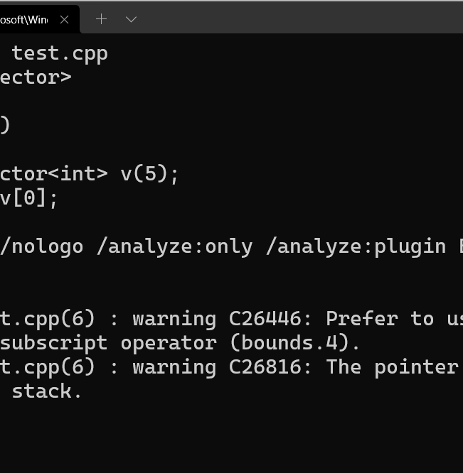
Static Analysis

Slide 6










int f(int x) {
if (x == 472349) {
return 5/(x-472349);
}
// ...
}
Notes:
Explain bug in code

Slide 7
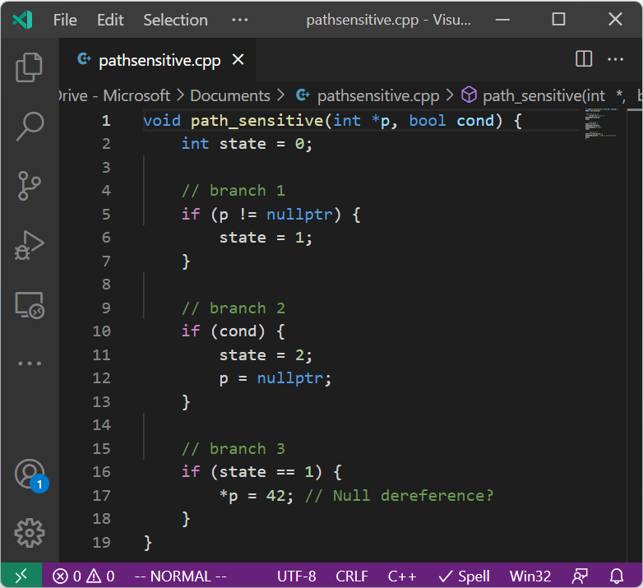
Flow-sensitive checks
Notes:
Explain there are 3 broad categories of analysis
: flow-insensitive – type checking
: flow-sensitive – will cover now
: path-sensitive – will cover a during the rest of the talk

Slide 8
Analysis state
void flow_sensitive(int *p, bool cond) {
int var = 0;
// branch 1
if (p != nullptr) {
var = 1;
}
// branch 2
if (cond) {
var = 2;
p = nullptr;
}
// branch 3
if (var == 1) {
*p = 42; // Null dereference?
}
}
p -> Unknown
Transition semi-lattice
p -> NotNull
Null
NotNull
p -> Unknown
Unknown
p -> Null
MaybeNull
p -> MaybeNull
p -> MaybeNull
Warning
Notes:
Talk about how unknown vs maybenull can help with confidence

Slide 9
void path_sensitive(int *p, bool cond) {
int var = 0;
// branch 1
if (p != nullptr) {
var = 1;
}
// branch 2
if (cond) {
var = 2;
p = nullptr;
}
// branch 3
if (var == 1) {
*p = 42; // Null dereference?
}
}
Some paths are infeasible:
Not taking branch 1, but taking branch 3
All warnings on infeasible paths are noise
Need info on the whole state!
Notes:
What did we learn?

Slide 10
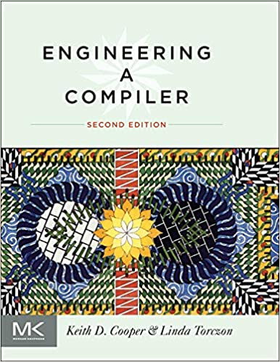
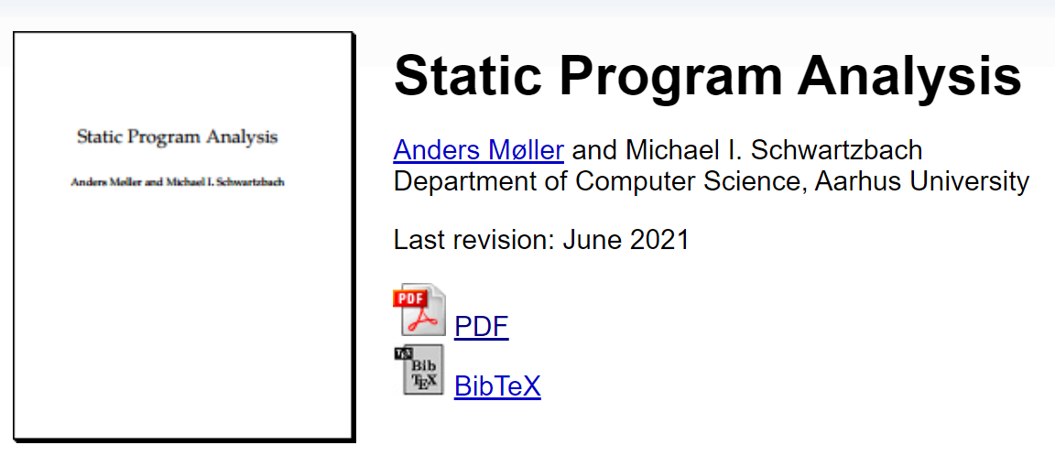
Flow-sensitive analysis resources
Notes:
Sometimes there are legitimate reason to not to care about path sensitivity
SPA lecture notes for the more mathematically inclined, it is free and actively maintained/improved
Engineering a compiler is more applied

Slide 11
Path-sensitive checks

Slide 12
p: ?1 cond: ?2 var: 0
void path_sensitive(int *p, bool cond) {
int var = 0;
// branch 1
if (p != nullptr) {
var = 1;
} else {}
// branch 2
if (cond) {
var = 2;
p = nullptr;
}
// branch 3
if (var == 1) {
*p = 42; // Null dereference?
}
}
p: ?1 cond: ?2 var: 1
?1 != 0
p: null cond: ?2 var: 0
p: null cond: 1 var: 2
p: ?1 cond: 0 var: 1
?1 != 0
p: null cond: 1 var: 2
p: null cond: 0 var: 0
p: ?1 cond: 0 var: 1
?1 != 0

Slide 13

p: ?1 cond: ?2 var: 0
void path_sensitive(int *p, bool cond) {
int var = 0;
// branch 1
if (p != nullptr) {
var = 1;
}
// branch 2
if (cond) {
var = 2;
p = nullptr;
}
// branch 3
if (var == 1) {
*p = 42; // Null dereference?
}
}
Program State
Program Point
Transitions
p: ?1 cond: ?2 var: 1
?1 != 0
p: null cond: ?2 var: 0
Store/Bindings
Path condition
p: null cond: 1 var: 2
p: ?1 cond: 0 var: 1
?1 != 0
p: null cond: 1 var: 2
p: null cond: 0 var: 0
p: ?1 cond: 0 var: 1
?1 != 0
Solver
Notes:
Anatomy of path sensitive analysis

Slide 14

Precision
Performance
ESP: Path-Sensitive Program Verification in Polynomial Time
Path-Sensitive Dataflow Analysis with Iterative Refinement
Notes:
Exponential in branching factor
Unbounded paths in the presence of loops (web server could answer request for all eternity)
We cannot achieve full precision no matter how much performance we are willing to sacrifice
Cannot check all paths -> cannot find all bugs
Sometimes we can merge states, when the tracked property is identical

Slide 15
MSVC has both
Path-sensitive
Flow-sensitive
Use after move
Concurrency checks
Variant clear
Enum Index
HResult
Nullptr dereference
more to come..
Coroutine lifetime checks
Most of CppCoreChecks
Pointer safety analysis
Ownership analysis
Lifetime analysis (preview)
more to come…
Notes:
Each link leads to a blogpost describing the checks along with the instructions how to enable them. Slides will be available.

Slide 16
Looking under the hood
Representing the store
Solving constraints
Guiding the analysis
Immutable data structures?
Modeling loops?

Slide 17
From source to values
struct S
{
int *p;
};
int f()
{
S a[10];
// ...
a[1].p = a[3].p;
*a[3].p = 5;
}
Heap
Stack
5
Object
Array: a
Element: 1
Element: 3
Member: p
Member: p
MemoryRegion -> Values
Notes:
We have multiple names to refer to the same value
Clang Static Analyzer is using graphical

Slide 18
From source to values
struct S
{
int *p;
};
int f()
{
S a[10];
// ...
a[1].p = a[3].p;
*a[3].p = 5;
}
AliasSet(a[1].p, a[3].p) AliasMaster -> Values
Location | Value
*a[1].p | 5
Notes:
This is the MSVC approach

Slide 19
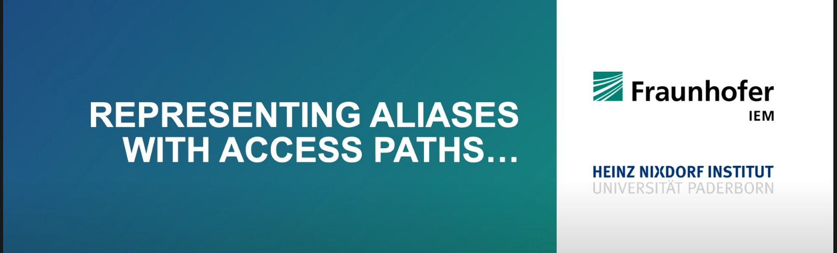
DECA I - Week 7 - c) Access paths

Slide 20
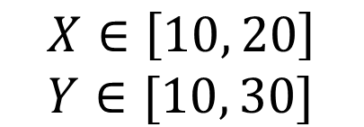
Intervals
Y
$$X∈\left[10, 20\right] \\ Y∈[10, 30]$$
X
Notes:
What values can X and Y have at a particular program point?
Intervals

Slide 21
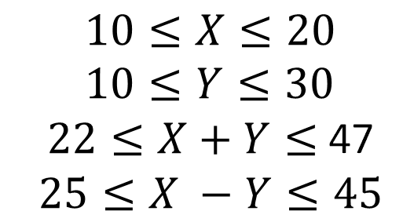
Octagonal
Y
$$10≤X≤20 \\ 10≤Y≤30$$ $22≤X+Y≤$47 $$25≤X −Y≤45$$
X
Notes:
Octagon

Slide 22
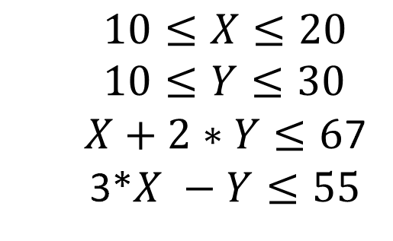
Polyhedra
Y
$$10≤X≤20 \\ 10≤Y≤30$$ $X+2∗Y≤6$7 3*$X −Y≤55$
X
Notes:
Polyhedra

Slide 23
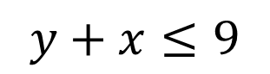
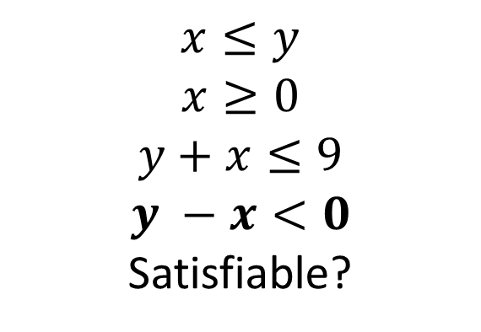
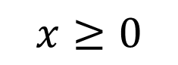
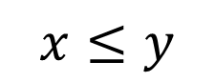
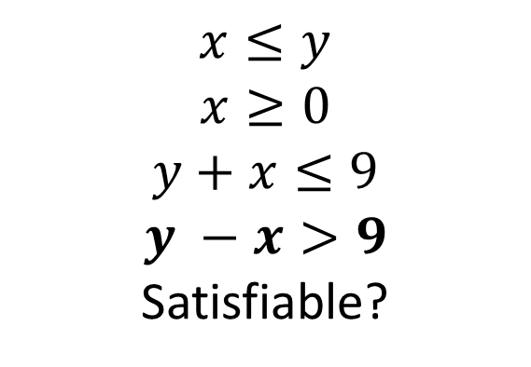
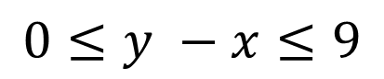
Queries
Given:
is
true?
int a[10];
int f(int x, int y)
{
if (x > y)
return f(y, x);
if (x < 0)
return -1;
if (y + x > 9)
return 0;
return a[y - x];
}
$$x≤y$$
$$x≥0$$
$$x≤y$$
$$x≥0$$
$$y+x≤9$$
$$y −x<0$$
Satisfiable?
$$x≤y$$
$$x≥0$$
$$y+x≤9$$
$$y −x>9$$
Satisfiable?
$$y+x≤9$$
$$0≤y −x≤9$$

Slide 24

Fourier-Motzkin elimination
Notes:
Proving the other overflow part is left as an exercise
This representation and solver is for integers, no overflows, unsigned types etc

Slide 25
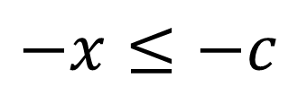
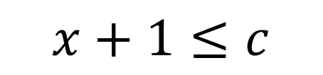
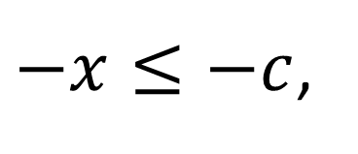
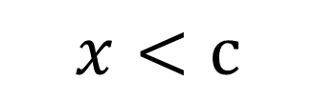
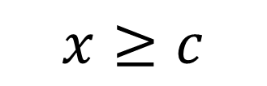
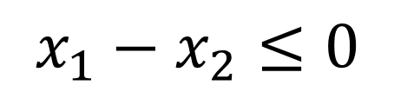
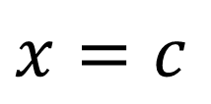
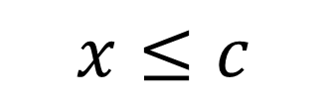
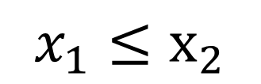
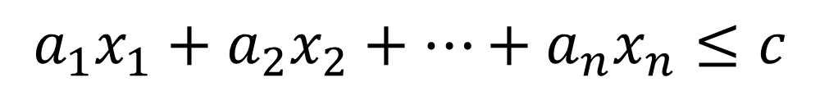
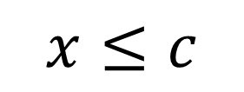
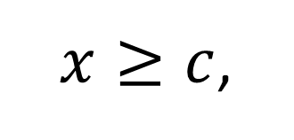
Constraints
$$a_{1}x_{1}+a_{2}x_{2}+…+a_{n}x_{n}≤c$$
$$x≥c$$
$$−x≤−c$$
$x=c$
$x≥c$,
$$x≤c$$
$−x≤−c$,
$$x≤c$$
$$x_{1}≤x_{2}$$
$$x_{1}−x_{2}≤0$$
$$x<c$$
$$x+1≤c$$
Notes:
Canonicalization

Slide 26

17 min -> 2h 54m 😱
Notes:
Refutation
SAT/SMT

Slide 27
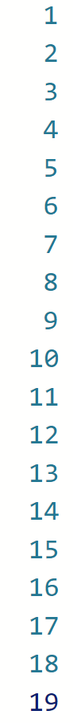
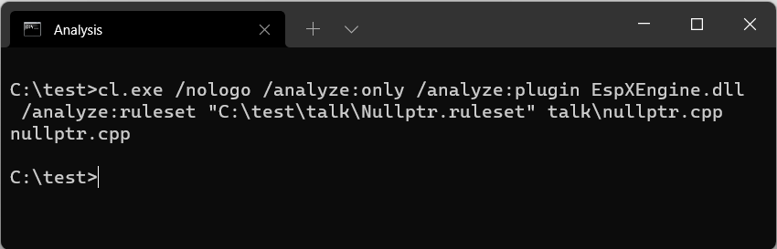
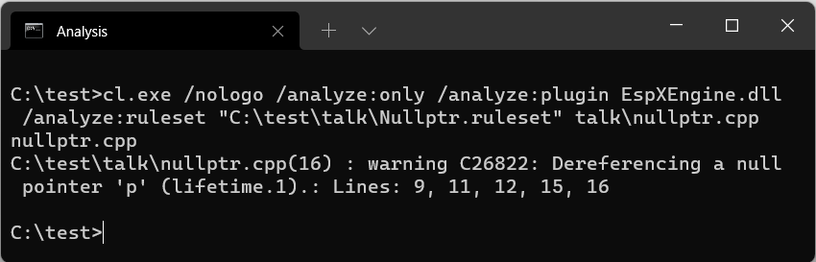
#include <sal.h>
_When_(x > 0, _Post_satisfies_(return != 0))
_When_(x < 0, _Post_satisfies_(return == 0))
bool isPositive(int x) {
return x > 0;
}
int foo(int *p, int x)
{
if (x < 0)
p = nullptr;
// ...
if (isPositive(x))
return *p;
return 42;
}
Notes:
Local vs inter-procedural
Key events

Slide 28
Lessons learned
Path-sensitive analysis is powerful, but power comes at a cost
We are actively looking into ways to make analysis more precise
There are a large set of checks in MSVC
Making intent explicit can help analysis, improve readability

Slide 29
Enjoy the rest of the conference!
Join #visual_studio channel on CppCon Discord https://aka.ms/cppcon/discord
Meet the Microsoft C++ team
Ask any questions
Discuss the latest announcements
Take our survey https://aka.ms/cppcon

Slide 30
Our Sessions
Monday 25th
Implementing C++ Modules: Lessons Learned, Lessons Abandoned – Cameron DaCamara & Gabriel Dos Reis
Tuesday 26th
Documentation in The Era of Concepts and Ranges – Sy Brand & Christopher Di Bella (Google)
Static Analysis and Program Safety in C++: Making it Real – Sunny Chatterjee
In-memory and Persistent Representations of C++ – Gabriel Dos Reis (online 27th)
Extending and Simplifying C++: Thoughts on pattern Matching using `is` and `as – Herb Sutter
Wednesday 27th
What's New in Visual Studio: 64-bit IDE, C++20, WSL 2, and more – Sy Brand & Marian Luparu
Thursday 28th
C++20’s <chrono> Calendars and Time Zones in MSVC – Miya Natsuhara
An Editor Can Do That? Debugging Assembly Language and GPU Kernels in Visual Studio Code – Julia Reid
Why does std::format do that? – Charlie Barto
Finding bugs using path-sensitive static analysis – Gabor Horvath (online 29th)

Slide 31
Thanks!
Notes:
Sunny had a more high level talk on Tuesday

Slide 32
Fourier-Motzkin elimination
Notes:
This representation and solver is for integers, no overflows, unsigned types etc

Slide 33
Resources

Slide 34
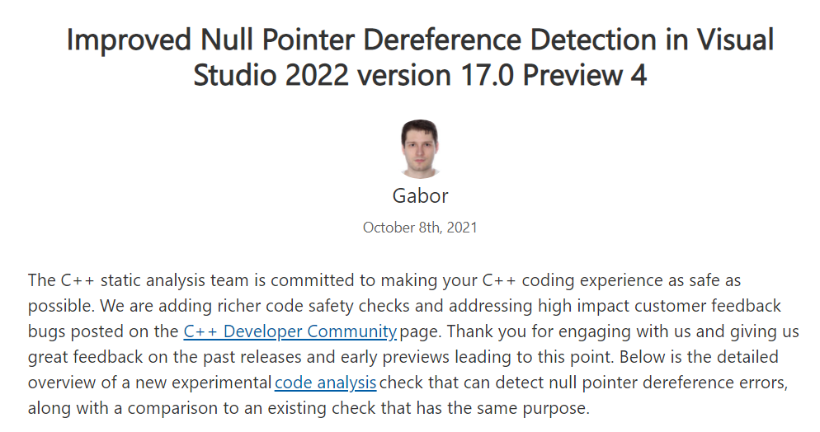
Improved Null Pointer Dereference Detection in Visual Studio 2022 version 17.0 Preview 4 - C++ Team Blog (microsoft.com)

Slide 35
